Slide 1

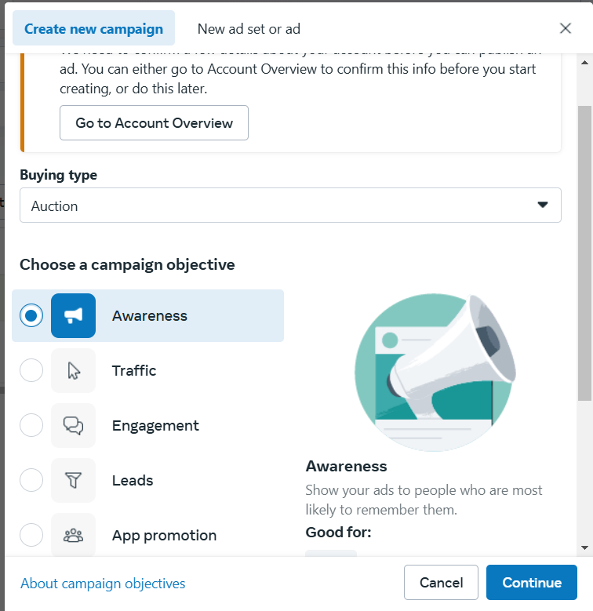
1
CAMPAIGN
Larana University | 2024

Slide 2
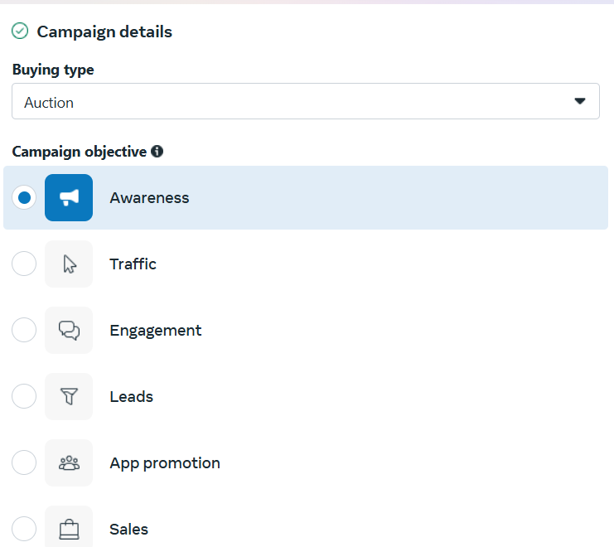
2
Larana University | 2024

Slide 3
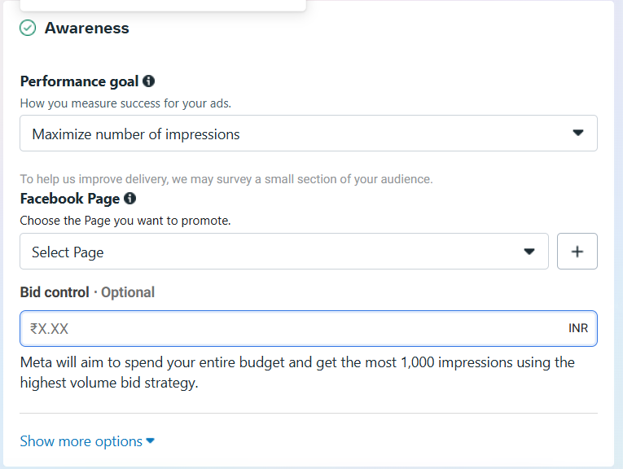
3
Larana University | 2024

Slide 4
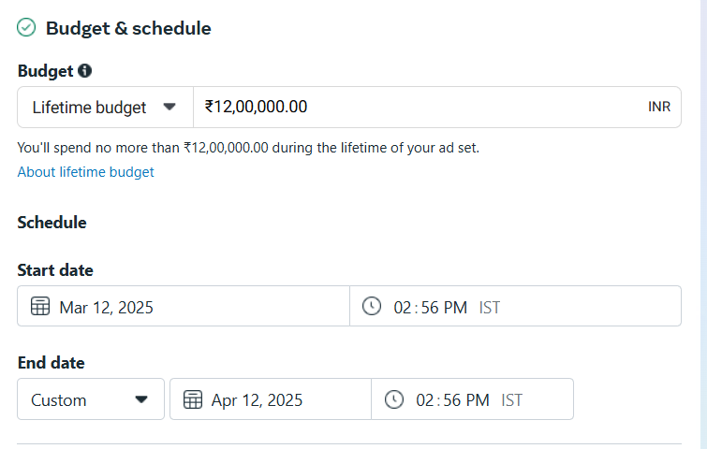

Slide 5
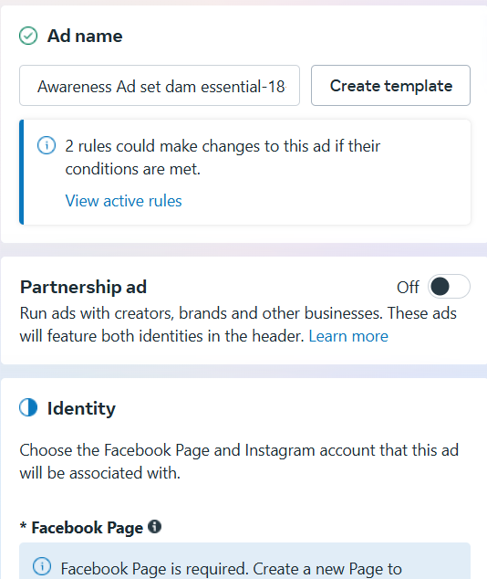
4
Larana University | 2024

Slide 6
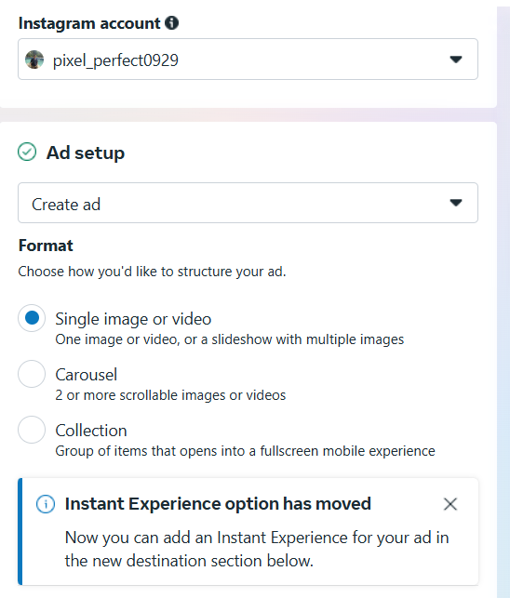
5
Larana University | 2024

Slide 7
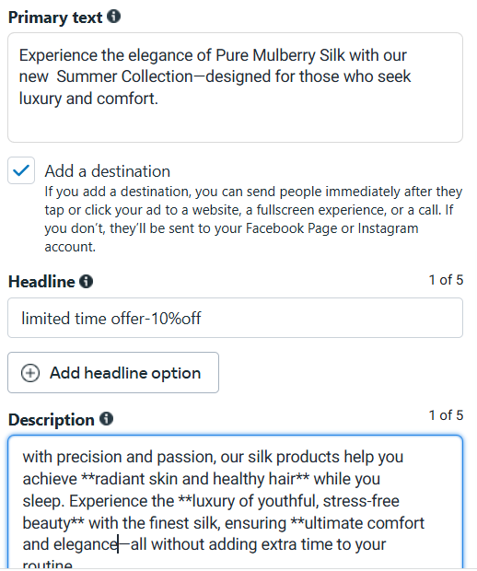
6

Slide 8
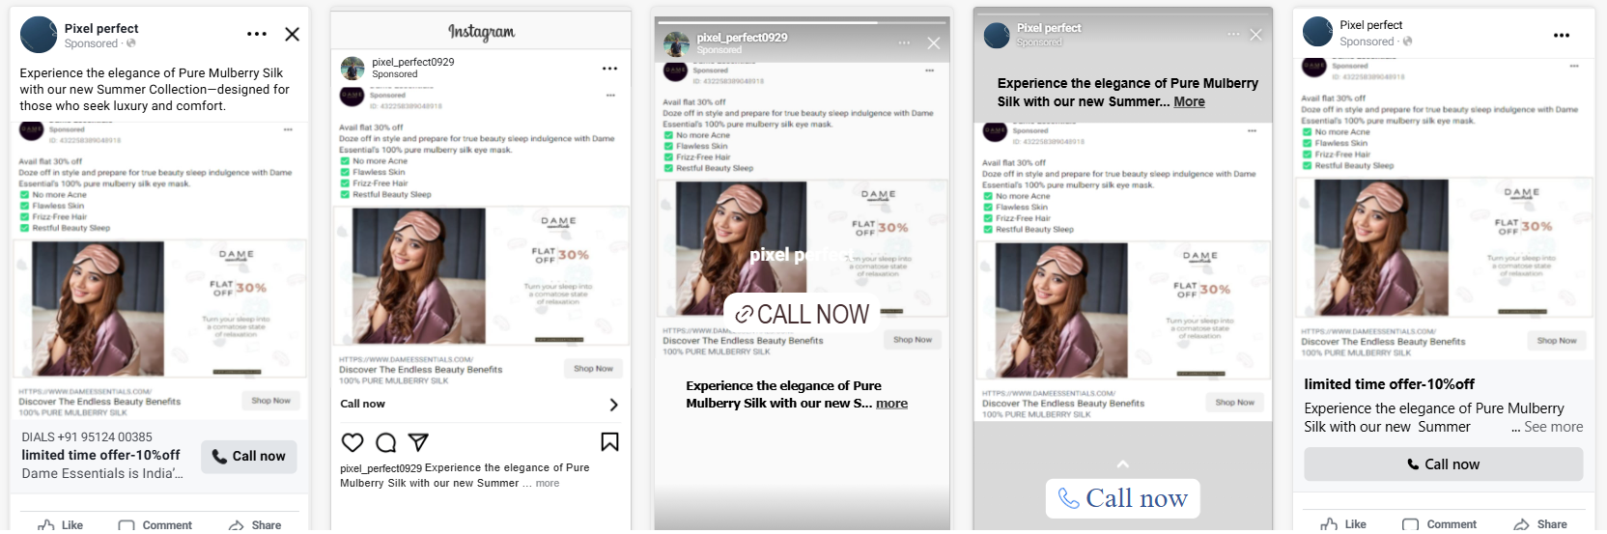
7

Slide 9
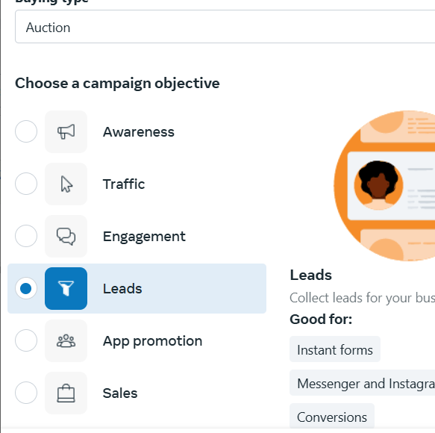
8

Slide 10
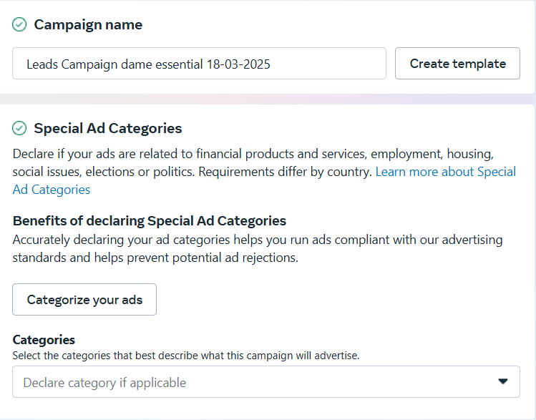
9

Slide 11
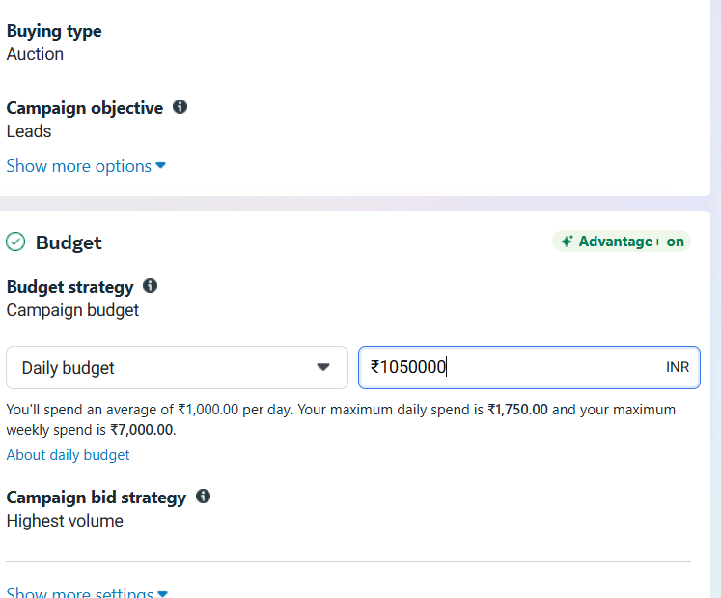
10

Slide 12
11

Slide 13
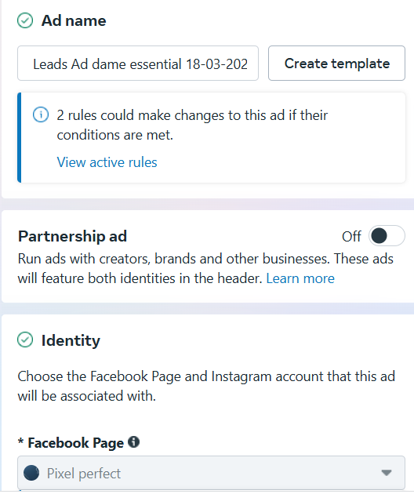
12

Slide 14
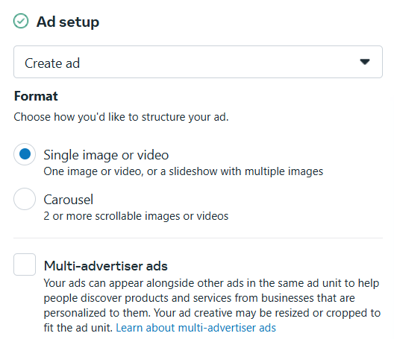
13

Slide 15
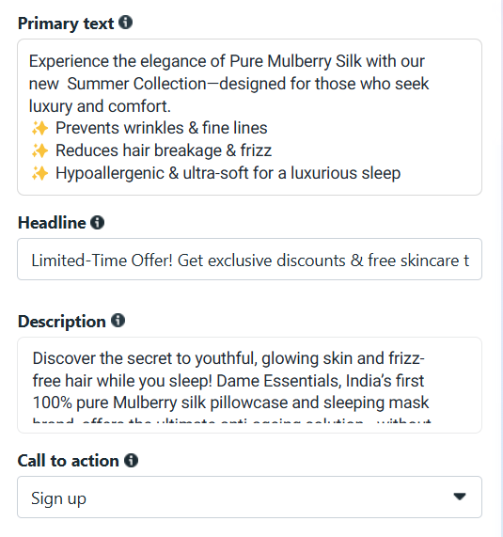

Slide 16
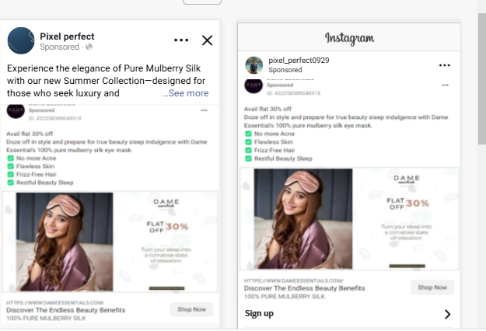

Slide 17
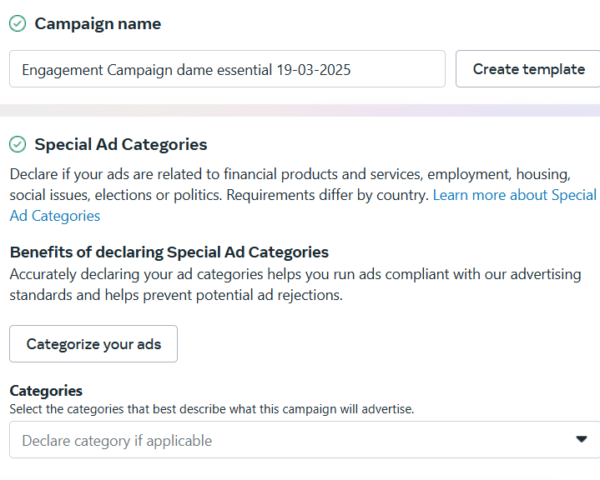

Slide 18
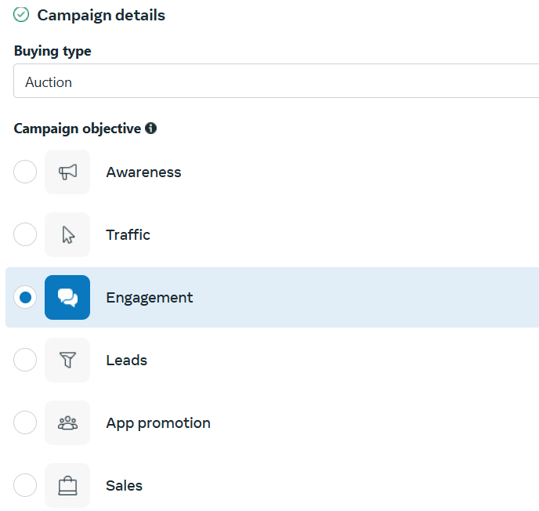

Slide 19
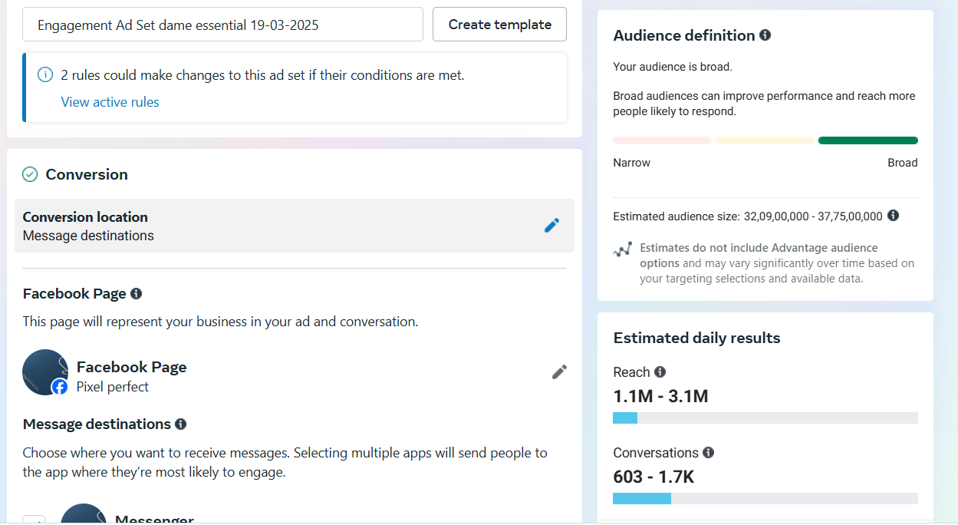

Slide 20
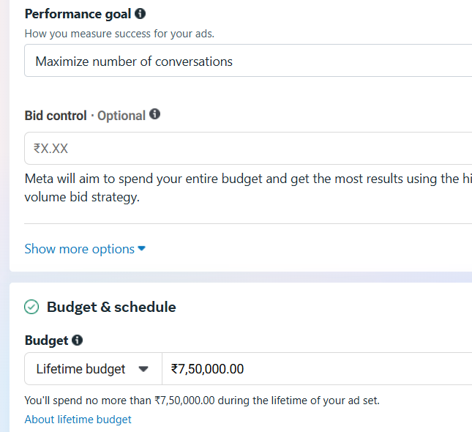

Slide 21
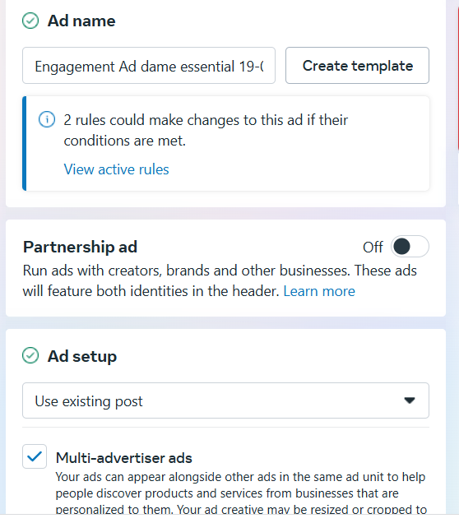

Slide 22
Here’s a structured breakdown of how to allocate the remaining Rs. 20 lakh for Facebook and Instagram ads while optimizing for higher impressions, CTR, lower bounce rate, increased session duration, and higher conversion rate to achieve positive ROI and ROAS.
1. Budget Allocation for Facebook & Instagram
ans: Out of Rs. 20 lakh, the budget will be allocated strategically based on audience behavior and past performance data:
Facebook Ads: Rs. 12 lakh (60%) – Suitable for detailed targeting, retargeting, and conversion-focused campaigns.
Instagram Ads: Rs. 8 lakh (40%) – Best for engaging creatives, video ads, and brand awareness campaigns.
This split is based on historical data, where Facebook has higher conversion potential, while Instagram performs better for engagement and reach.

Slide 23
2. Achieving Higher Impressions and CTR, Lower Bounce Rate
Ad Strategy:
Focus on video and carousel ads to increase engagement and CTR.
Optimize ad creatives with compelling copy and clear CTAs.
A/B testing for different audience segments to find the best-performing ones.
Expected Outcome:
Impressions: 10M+ across platforms.
CTR Improvement: 2.5% to 4% through ad copy optimization and audience targeting.
Bounce Rate Reduction: From 60% to 45% by improving landing page speed and relevance.

Slide 24
3. Increasing Average Session Duration
Landing Page Optimization:
Faster loading time (<3 sec).
Engaging and interactive content with videos and testimonials.
Strong internal linking to guide users through multiple pages.
Expected Outcome:
Average Session Duration Increase: From 40 sec to 90 sec.
4. Higher Conversion Rate & Lower Abandon Rate
Conversion Optimization:
Retargeting abandoned carts with special offers.
One-click checkout process to reduce friction.
Email & WhatsApp follow-ups to recover abandoned carts.
Expected Outcome:
Conversion Rate Increase: From 1.5% to 3.5%.
Cart Abandonment Rate Reduction: From 70% to 50%.

Slide 25
5. Number of Units to Sell for Positive ROI
Target Revenue Goal: Rs. 50 lakh
Average Selling Price per Unit: Rs. 2,500
Units to Sell for Breakeven: Rs. 20L ÷ Rs. 2,500 = 8,000 units
Units to Sell for Positive ROI (2.5x ROAS): Rs. 50L ÷ Rs. 2,500 = 20,000 units
6. Average Purchase Value to Aim for Positive ROAS & ROI
Target AOV (Average Order Value): Rs. 3,000
Ad Spend per Order (Assuming 3.5% Conversion Rate): Rs. 1,500
ROAS (Return on Ad Spend) Calculation:
Target Revenue: Rs. 50L
Target ROAS: 2.5x (Revenue ÷ Ad Spend)
Required Sales: Rs. 50L ÷ Rs. 3,000 = 16,667 orders

Slide 26
7. Achieving Positive ROAS and ROI with Numbers
Investment: Rs. 20L
Target Revenue: Rs. 50L
ROAS = Rs. 50L ÷ Rs. 20L = 2.5x
Profit Calculation:
Gross Revenue: Rs. 50L
Cost of Goods (40% of revenue): Rs. 20L
Ad Spend: Rs. 20L
Net Profit: Rs. 10L
✅ Final Outcome: Positive ROI of 50% and ROAS of 2.5x
Key Takeaways for Achieving ROI and ROAS
Optimized Budget Allocation between Facebook (60%) and Instagram (40%).
High-Impact Creatives with video and carousel ads to improve CTR.
Conversion-Focused Retargeting to reduce abandoned carts and increase AOV.
Landing Page Optimization to improve session duration and lower bounce rates.
Data-Driven Selling Strategy to sell 16,667+ units for profitable scaling.
By executing this structured plan, we ensure a high-performing ad campaign that delivers positive ROI and profitability. 🚀

Slide 27
excel you tube
https://docs.google.com/spreadsheets/d/1r-l6iLPWLli6kgWvZbC4PDpN8A5yDiqjFAABaMHzKCs/edit?gid=1065451116#gid=1065451116

Slide 28
(2).What is the use of E-mail marketing?
Uses of E-Mail Marketing
E-mail marketing is a cost-effective way to engage customers, promote products, and drive sales.
Key Benefits:
Customer Engagement – Builds trust and strengthens relationships.
Product Promotion – Sends offers, discounts, and new product updates.
Lead Generation – Converts potential customers into buyers.
Brand Awareness – Keeps the brand in customers' minds.
Cost-Effective – Affordable compared to traditional advertising.
Customer Retention – Encourages repeat purchases and loyalty.
Event Promotion – Notifies customers about sales and events.
Feedback Collection – Gathers insights through surveys.
Automation & Personalization – Sends targeted and automated messages.
Performance Tracking – Measures success with analytics.
Conclusion:
E-mail marketing boosts engagement, sales, and brand growth efficiently.

Slide 29
(3).What goals you can achieve with the help of email marketing?
1. Increase Sales & Revenue
Promote products, special offers, and discounts to drive conversions.
Encourage repeat purchases and upsell/cross-sell products.
2. Build Customer Relationships & Loyalty
Send personalized messages to engage customers.
Provide valuable content, updates, and exclusive offers.
3. Boost Brand Awareness
Keep your brand in customers' minds through regular communication.
Share company news, new products, and achievements.
4. Generate & Nurture Leads
Convert potential customers into buyers with targeted campaigns.
Offer incentives like free trials, ebooks, or discounts.
5. Improve Customer Retention
Re-engage inactive customers with special offers and updates.
Use automated emails like abandoned cart reminders.

Slide 30
(5).What is affiliate Marketing?
Affiliate marketing is a performance-based marketing strategy where a business rewards affiliates (partners) for driving traffic or sales to their website through the affiliate’s marketing efforts. Affiliates earn a commission when someone makes a purchase or completes a specific action (like signing up) using their unique referral link.
How It Works:
Merchant (Advertiser): The company or brand that sells the product or service.
Affiliate (Publisher): The person or business that promotes the merchant’s products.
Consumer: The person who clicks on the affiliate link and makes a purchase.
Affiliate Network (Optional): A platform that connects merchants with affiliates and tracks commissions.
Example:
A blogger writes a review about a new smartphone and includes an affiliate link to Amazon. If a reader clicks the link and buys the smartphone, the blogger earns a commission.
Affiliate marketing is widely used in e-commerce, blogging, YouTube, and social media, making it a popular way to earn passive income.

Slide 31
(6.)List some famous websites available for affiliate marketing.
Here are some famous websites for affiliate marketing:
1. Amazon Associates
One of the largest and most popular affiliate programs.
Allows affiliates to earn commissions by promoting Amazon products.
2. ClickBank
Specializes in digital products like eBooks, courses, and software.
Offers high commission rates.
3. ShareASale
A large affiliate network with thousands of merchants.
Covers a wide range of products and services.
4. CJ Affiliate (Commission Junction)
Connects affiliates with top brands.
Offers advanced tracking and reporting tools.
5. Rakuten Advertising
Works with well-known brands across multiple industries.
Provides reliable payouts and support.
6. PartnerStack
Focuses on software and SaaS affiliate programs.
Used by companies like Shopify and Monday.com.
7. eBay Partner Network
Allows affiliates to earn by promoting eBay listings.
Offers a global reach.
8. Bluehost Affiliate Program
Popular for web hosting referrals.
High commission payouts for each signup.
9. Impact
Works with top brands and influencers.
Provides advanced tracking and analytics.
10. FlexOffers
A diverse network with a variety of merchants.
Offers both digital and physical products.
These websites provide great opportunities to earn commissions by promoting products and services online.

Slide 32
(7).Which are the platforms you can use for affiliate marketing?
1. Websites & Blogs
Create a niche website or blog to promote affiliate products.
Write product reviews, comparisons, and how-to guides.
Example: WordPress, Blogger, Wix.
2. YouTube
Create video content like product reviews, tutorials, and unboxing videos.
Add affiliate links in the video description.
3. Social Media Platforms
Share affiliate links on social media platforms with engaging content.
Platforms:
Facebook (Groups, Pages, Stories)
Instagram (Stories, Reels, Bio Link)
TikTok (Short videos with affiliate links)
Twitter/X (Tweets and threads with links)
Pinterest (Affiliate links in pins)
4. Email Marketing
Build an email list and send product recommendations.
Use newsletters to promote affiliate offers.
5. Podcasts
Mention affiliate products in podcast episodes.
Include links in show notes.
6. Forums & Online Communities
Share affiliate links in relevant discussions.
Examples: Quora, Reddit (be careful with rules), niche forums.
7. Affiliate Networks
Join platforms that connect affiliates with brands.
Examples: ShareASale, CJ Affiliate, ClickBank.
8. Mobile Apps
Create an app that integrates affiliate marketing.
Example: A deals or coupon app with affiliate links.

Slide 33
(4).Set-up an automation email for www.esellerhub.com abandon cart.
● Suggest a Subject for the email
● Prepare an email
Subject: Don’t Forget! Enjoy 10% Off Your Cart 🛒✨
Email:
Hi [Customer's Name],
We noticed you left some great items in your cart at eSellerHub! To make your decision easier, here’s a special 10% discount just for you. But hurry—this offer won’t last long!
🛍 Here’s what’s waiting for you:
[Insert dynamic product details]
🎉 Use code: SAVE10 at checkout and enjoy 10% off your order!
✅ A smooth and secure checkout
✅ Fast shipping options
✅ Exclusive deals on your favorite products
🔗 Click below to return to your cart and apply your discount:
[Return to My Cart & Save 10%]
But hurry! This exclusive discount expires in [XX] hours.
Need help? Our support team is here for you! Contact us at [support email] or visit our help center.
Happy shopping!
The eSellerHub Team

